Slide 1


James A Robertson and Associates
Effective Strategic Business Solutions
Strategy
What is it?
How to develop actionable plans
Live On-line Presentation (Webinar)
15 February 2013
Dr James Robertson PrEng
The ERP Doctor
Copyright 2004 through 2013
James@JamesARobertson.com
Notes:
NB remember to have a chair to stand on
Make sure to take the CRITICAL FACTORS BOOK with you
An engineer with a PhD in engineering

Slide 2
Who is James Robertson?
Civil Engineer
Grounding in economics
Military strategic training
Strategic implementation of business computer systems for over thirty years – create sustainable competitive advantage
Consulting and facilitating with regard to strategy and strategic solutions for over twenty years
Engineering approach to strategic analysis and planning
Pioneered methods that work in practice

Slide 3
Agenda
Strategy – what is it and how to develop actionable plans
What IS strategy really?
Strategy defined in one sentence that everyone understands
How to define the strategic environment?
How to measure strategic performance
Driving strategic performance through to measurable and actionable plans
Driving strategic performance through to Key Performance Indicators
Summing up

Slide 4
Agenda
Strategy – what is it and how to develop actionable plans
What IS strategy really?

Slide 5
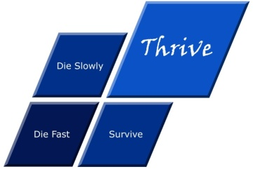




What is strategy?
Die fast
Thrive
Tactics – Doing things right ➔
Die slowly
Survive
Strategy – Doing the right things ➔
Professor Malcolm McDonald – http://www.malcolm-mcdonald.com/

Slide 6
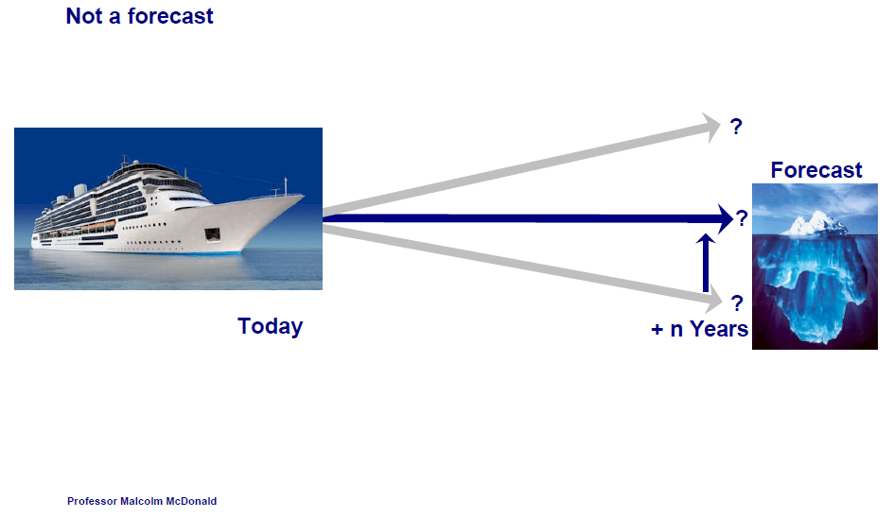
The time dependency of strategy
Professor Malcolm McDonald -- http://www.malcolm-mcdonald.com/

Slide 7
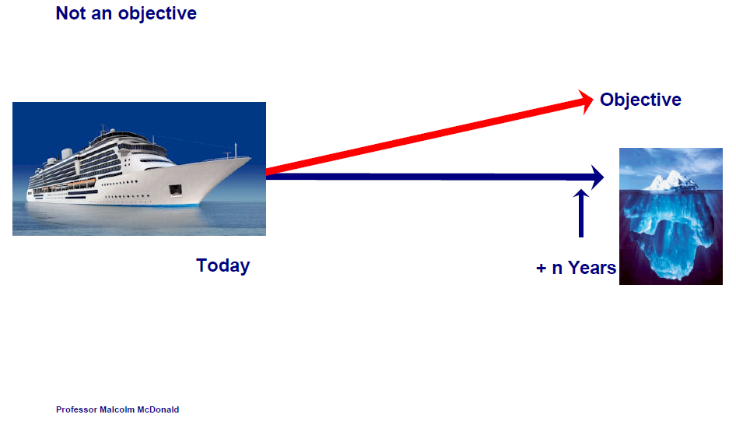
The time dependency of strategy
Professor Malcolm McDonald -- http://www.malcolm-mcdonald.com/

Slide 8
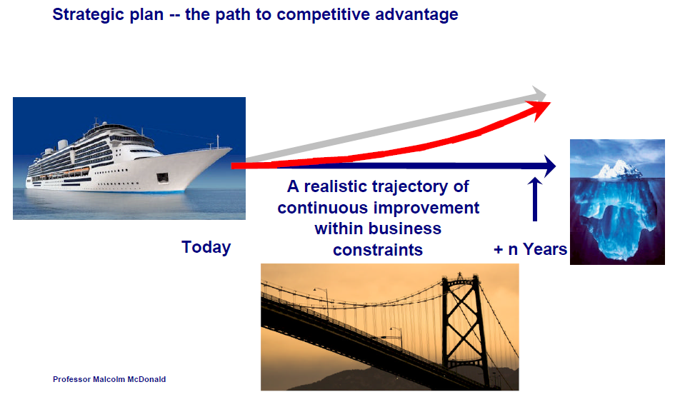
The time dependency of strategy
Professor Malcolm McDonald

Slide 9
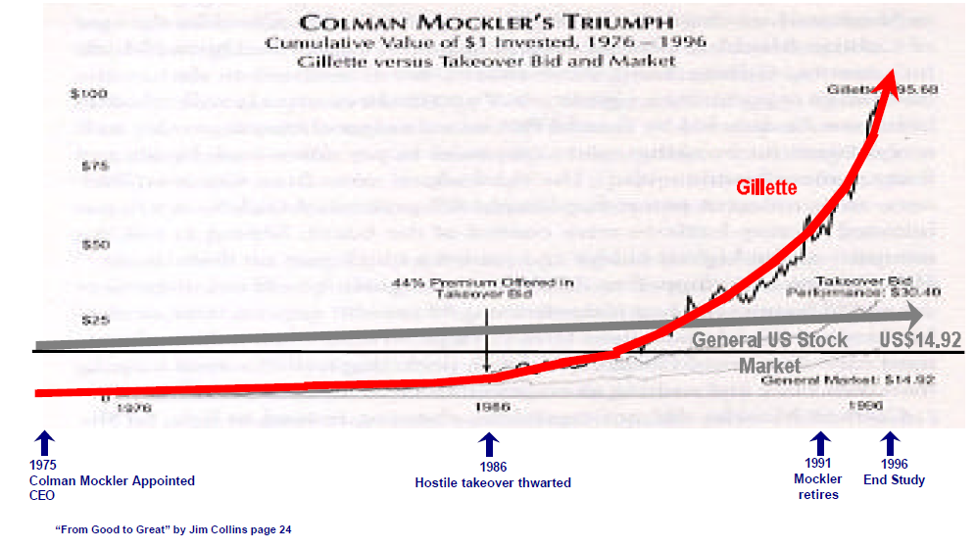
The time dependency of strategy
from good to GREAT

Slide 10
Some vital considerations in designing and implementing strategic plans
Context to the presentation that follows
Vital principles that must be understood in order to develop and implement strategic plans that work
Consolidated view based on more than three decades of strategic experience

Slide 11
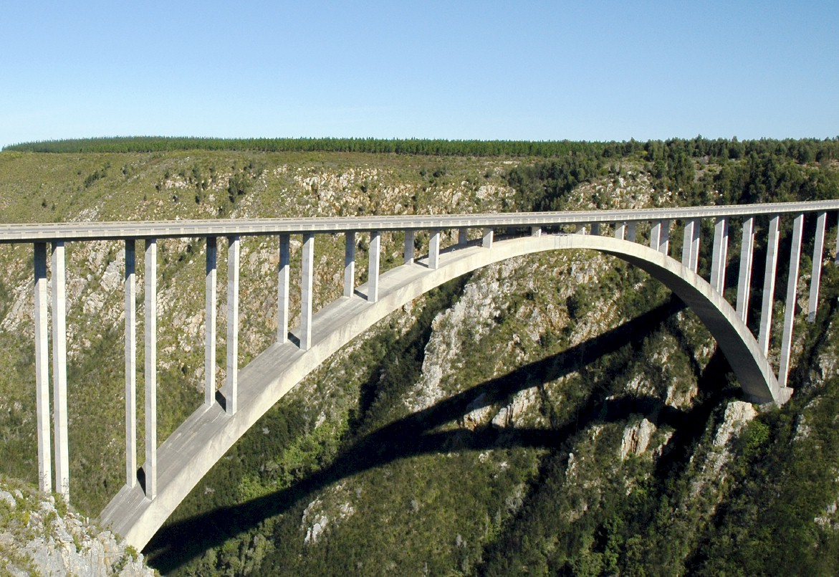
An ENGINEERING approach to strategy
Notes:
There is a fundamental difference in approach when one designs a bridge NOT TO FALL DOWN
Contrast this with the IT paradigm which could be called “designed to fail”

Slide 12
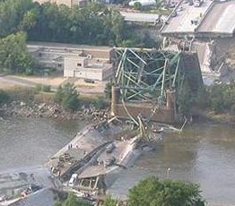

Engineers do NOT design bridges to stand up
Notes:
DHL, Prochem,

Slide 13
They design bridges NOT to fall down
Notes:
There is a fundamental difference in approach when one designs a bridge NOT TO FALL DOWN
Contrast this with the IT paradigm which could be called “designed to fail”

Slide 14

Some harsh facts
Seventy percent of I.T. investments fail TOTALLY
"19 out of 20 ERP implementations “do not deliver what was promised“
Seventy percent of BPM investments fail
Ninety percent of strategic plans fail
How does one prevent failure?
and thereby achieve SUCCESS?
Notes:
KEEP SHORT AND SIMPLE
MY FATHER
How did i get involved with computers? – my father was a visionary -- In 1981, having gathered over 7,000 pages of research data for my PhD the University mainframe did not have space to store even one page of data. My father purchased me one of the first desktop PC’s in the days of the Apple and Apricot and 123, etc – at a cost of R12,000 two and a half times my research grants! – I very quickly discovered that there was a HUGE gap between what the salesman told me the computer could do and getting it to do it – so, in that respect, NOTHING HAS CHANGED ☺ -- I then put myself through a self taught computer science programme and learned to program, learned to type and finally wrote an award winning PhD thesis – at the same time I computerized my father’s investment consulting business and we were able to double turnover in twelve months and create an enduring revenue stream that lasted for over ten years because we were able to do things that much larger businesses were not able to do – it was then that I began to understand that the strategic application of information technology COULD deliver great value and one of my greatest frustrations is the extent to which few businesses achieve this potential – the rest of this presentation is about lessons I have learned that I hope will help YOU to make a difference in your business with IT

Slide 15



What is NOT an engineering approach?
Notes:
What is not an engineering approach? – Dramatically walk to chair – did this ever happen to you? –
WHEN SLEEPING
when i was a child i used to dream that i would stand on a chair and flap my arms and fly around the room --i have to say that that is NOT an engineering approach – as much as i may be convinced i can fly i have to say to you that were i to stand on top of a skyscraper and flap my arms and jump i would hit the ground at great speed and almost certainly die – that is NOT an engineering approach and yet many seem to think they can use software to do things magically – many are hypnotized and mesmerized by IT – are you? CLICK for rabbit out of the hat

Slide 16
Agenda
Strategy – what is it and how to develop actionable plans
What IS strategy really?
Strategy defined in one sentence that everyone understands

Slide 17
What IS Strategy?
The Essence of WHY the Organization exists and HOW it THRIVES
Virtually NEVER changes
Intuited
Discovered NOT invented

Slide 18
Three alternative ERP value scenarios Unlocking the TRUE potential of ERP
100 / 1,000 x the norm ???
1,000
XXX 10
This is the ONLY valid scenario but it seldom occurs
3. Strategic customization
With CEO Custody
Relative strategic value measured in terms of business competitiveness, growth and profitability
2. Strategic precision configuration with CEO Executive Custody
1. Current industry norm for process based “Best Practice”
X 1
100
10
X 0.01
0
0
0

Slide 19
Case Study: Strategic Engineered Precision Configuration WITH Clever Customization to support the ESSENCE
Stalled ERP implementation
CEO bought into “ERP as a strategic resource” based on my approach
Highly structured strategic Product Class taxonomy
Clever software to add products and maintain high quality master data
Projects module
Brand Management expense taxonomy
Clever software to create a project for every brand line with these expense heads
Direct integration with General Ledger
Comprehensive Brand Project Management and reporting to Principals in Europe
New account → increased turnover 25% could do something competitors could NOT do
Dramatic improvements in competitiveness, growth and profitability are the ONLY valid arbiters of the success of an ERP implementation or a strategic plan

Slide 20

Pulse Measurement
Concise diagnostic intervention – 1 to 10 days
Starts with strategic executive interviews
– understand the Essence of the Business and
how it Thrives and Critical Concerns
3. Drill down to systems
4. +/- 7 bullet point findings, weighted
5. +/- 7 recommended actions, weighted
6. Findings frequently so obvious and so
practical client can continue unaided
7. Strategic advisory and / or project
leadership to implement
recommendations
!?*@
Notes:
KEEP SHORT AND SIMPLE
MY FATHER
How did i get involved with computers? – my father was a visionary -- In 1981, having gathered over 7,000 pages of research data for my PhD the University mainframe did not have space to store even one page of data. My father purchased me one of the first desktop PC’s in the days of the Apple and Apricot and 123, etc – at a cost of R12,000 two and a half times my research grants! – I very quickly discovered that there was a HUGE gap between what the salesman told me the computer could do and getting it to do it – so, in that respect, NOTHING HAS CHANGED ☺ -- I then put myself through a self taught computer science programme and learned to program, learned to type and finally wrote an award winning PhD thesis – at the same time I computerized my father’s investment consulting business and we were able to double turnover in twelve months and create an enduring revenue stream that lasted for over ten years because we were able to do things that much larger businesses were not able to do – it was then that I began to understand that the strategic application of information technology COULD deliver great value and one of my greatest frustrations is the extent to which few businesses achieve this potential – the rest of this presentation is about lessons I have learned that I hope will help YOU to make a difference in your business with IT

Slide 21
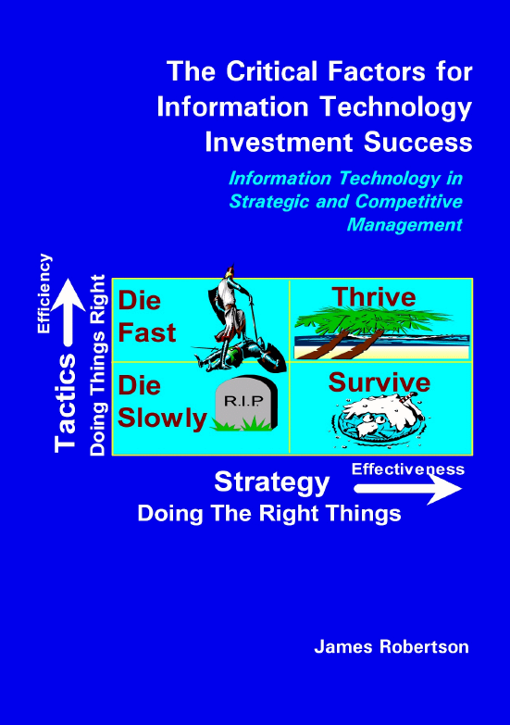
Analysis of consolidated findings
Notes:
WHAT CAUSES IT FAILURE?
Since 1993, analysed in 2003, course, book
Sustainable versus experimentation
People
The factors causing IT failure – in 1993 I became aware of the high failure rate of IT projects and started to talk about it – as a consequence i was asked to investigate many failed or failing projects and to help to turn them around – over the years i built up a large catalogue of the factors causing failure – in 2003 i undertook a critical issues analysis of the factors causing failure and arrived at a list of seven critical factors causing failure together with the critical factors for success which then became the subject of a course and subsequently a book – HOLD UP THE BOOK – since then i have advised many clients and led a number of significant projects and consistently validated the basic analysis
The biggest single factor causing failure is Mythology at 30% followed by lack of executive custody and inappropriate governance at 25%

Slide 22
Factors causing strategy implementation failure

Slide 23
Top down (CEO led) versus bottom up design
Top Down – Strategy Focused
Bottom Up – Process Focused

Slide 24
Process obsession example versus STRATEGIC design
Big brand ERP, big brand implementer
  Project stalled and restarted
  Running for three years and NO DELIVERABLE!!!
  Thick files of process documentation
  “Swimlanes”, “User stories”, “Flow charts”
  You name it they had it
  Except a deliverable
i.e. Process a complete waste of time and money and caused massive delays!

Slide 25
The brutal truth
Real processes are much more diverse and more complex than most people realize
  probably at least seven creditors processes
Processes are seldom if ever defined in most businesses
We hack it with the way the people we hire do it
Process is only relevant IF all the rest of the business is highly optimized
Process is an EXECUTIVE DESIGN OUTPUT NOT an input
There is NO SUCH THING as the Strategic process
Provide quality information on which to base quality decisions – one really good strategic decision could repay the entire investment!
One really BAD decision can destroy the business

Slide 26
Factors for strategy implementation success
Information and documentation

Slide 27
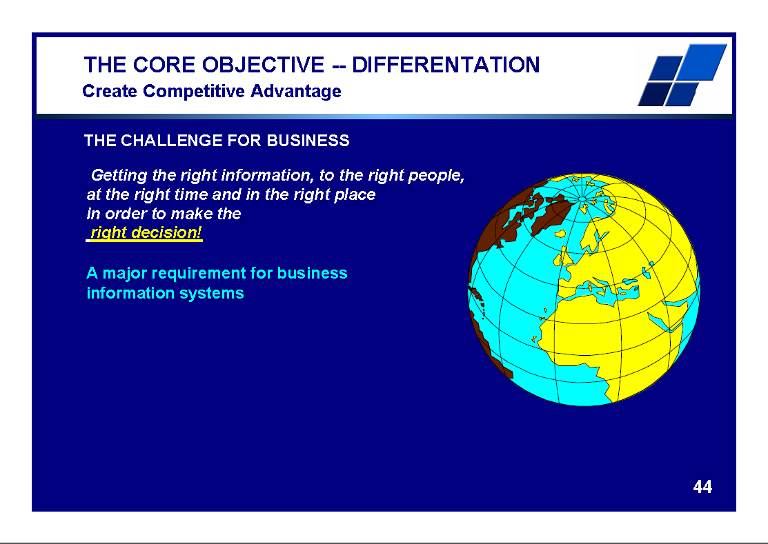
There IS great opportunity
ERP can and should add value
Notes:
Professor Richard Nolan states that "I.T. is the next corporate disaster waiting to happen”
And postulates that soon there will be an Enron level corporate failure
Do you remember Fedsure Health – tell the story SHORT

Slide 28
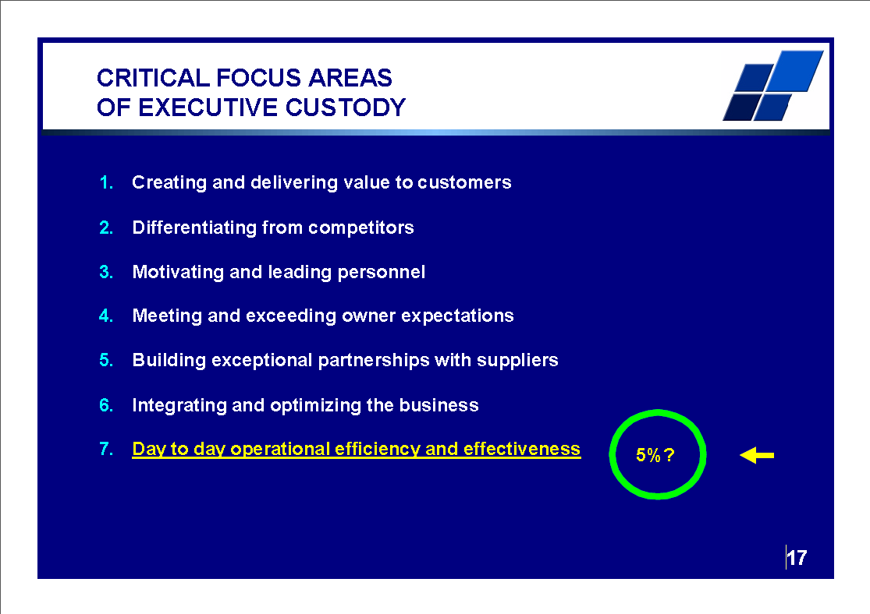
Strategic issues
Engage HERE
Notes:
Professor Richard Nolan states that "I.T. is the next corporate disaster waiting to happen”
And postulates that soon there will be an Enron level corporate failure
Do you remember Fedsure Health – tell the story SHORT

Slide 29
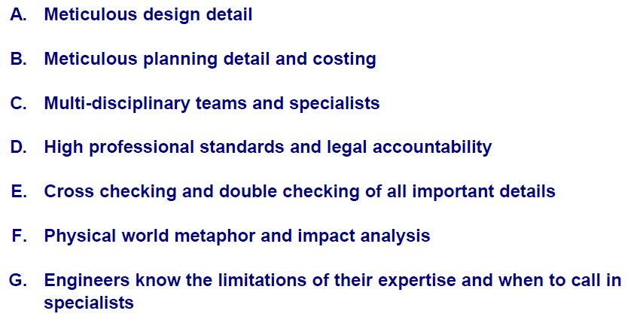
The engineering approach

Slide 30
Agenda
Strategy – what is it and how to develop actionable plans
What IS strategy really?
Strategy defined in one sentence that everyone understands
How to define the strategic environment?

Slide 31
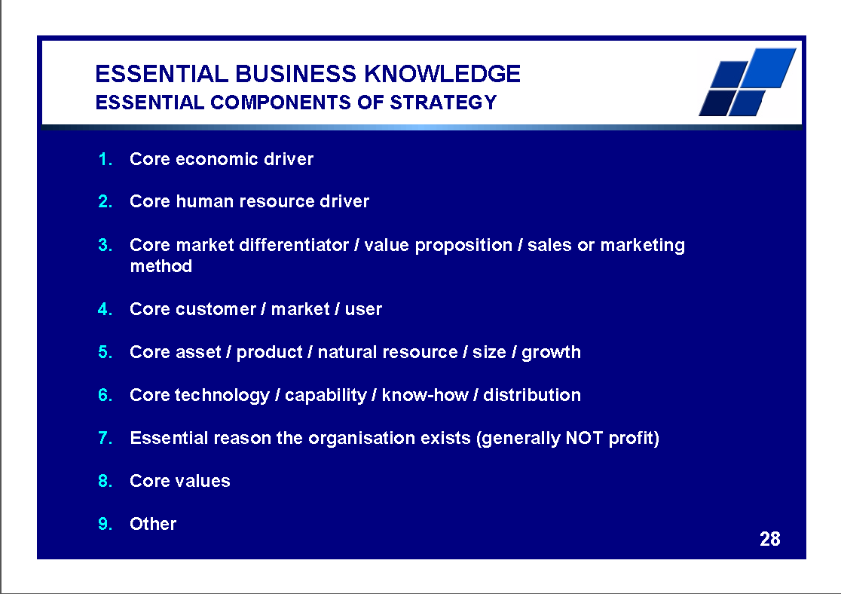
There IS great opportunity
ERP can and should add value
Refer ALSO Michel Robert on “Strategic Driving Force”
http://www.decisionprocesses.com/
Notes:
Professor Richard Nolan states that "I.T. is the next corporate disaster waiting to happen”
And postulates that soon there will be an Enron level corporate failure
Do you remember Fedsure Health – tell the story SHORT

Slide 32
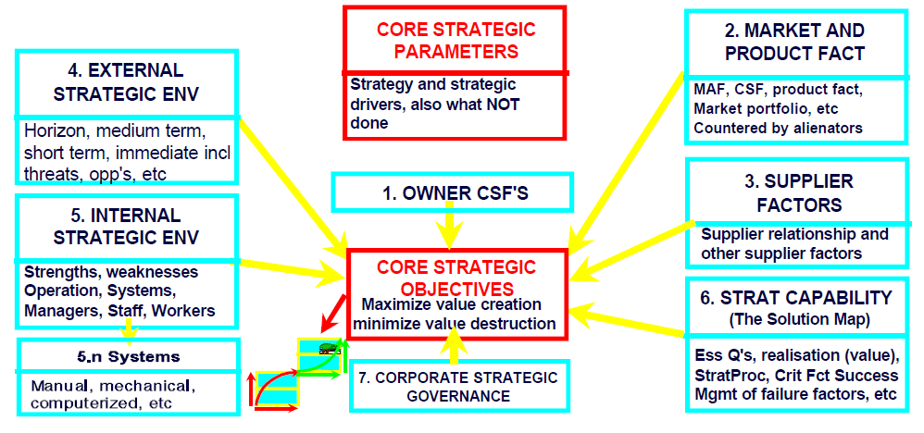
Analysis of the strategic environment

Slide 33
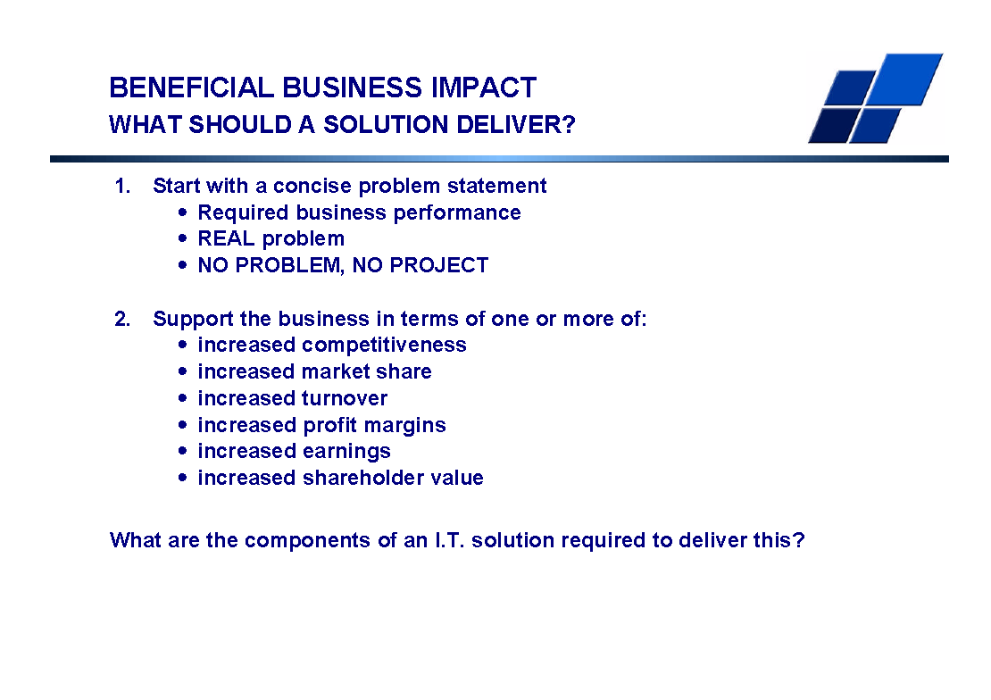
There IS great opportunity
ERP can and should add value
Notes:
Professor Richard Nolan states that "I.T. is the next corporate disaster waiting to happen”
And postulates that soon there will be an Enron level corporate failure
Do you remember Fedsure Health – tell the story SHORT

Slide 34
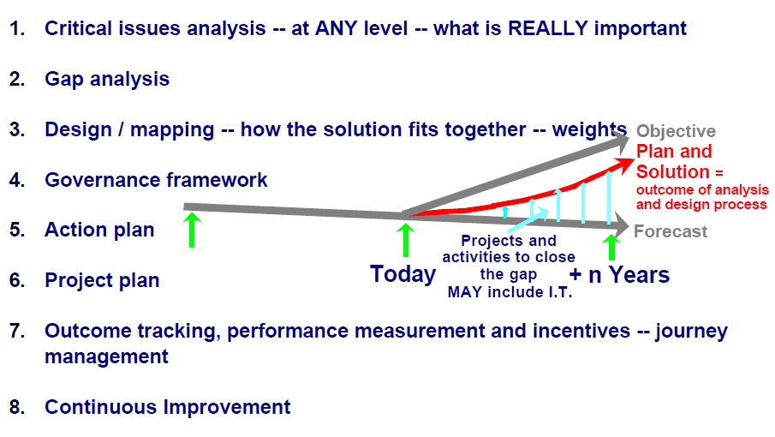
Developing a robust strategic design

Slide 35
Determining the ESSENCE of the business and how it thrives
Experienced strategic facilitator
Interview each executive one on one starting with the CEO
“Please will you tell me the essence of your business and how it thrives – what differentiates you from your competition?”
Listen carefully
Take lots of notes
After completing the interviews synthesize ALL the views to arrive at a SINGLE SENTENCE amplified as necessary with further detail
If an executive differs with the CEO then, unless the CEO has just arrived, the CEO’s view must prevail, particularly if the CEO is the founder or has been there for many years
New executives can be FAR off the mark

Slide 36
Strategic Snapshots – StratSnap©
One focus question = one Snapshot
Constantly narrowing focus to the 20% of issues that will deliver 80% of the value
Brainstorm
Synthesize Critical Factors -- seven
Weight – relative importance
Score – performance – historic, current, forecast, objective
Weighted Gap
Feeds StratGap© gap analysis method
Feeds Strategic Action Plan
Feeds the Strategic Project Plan
Feeds implementation

Slide 37
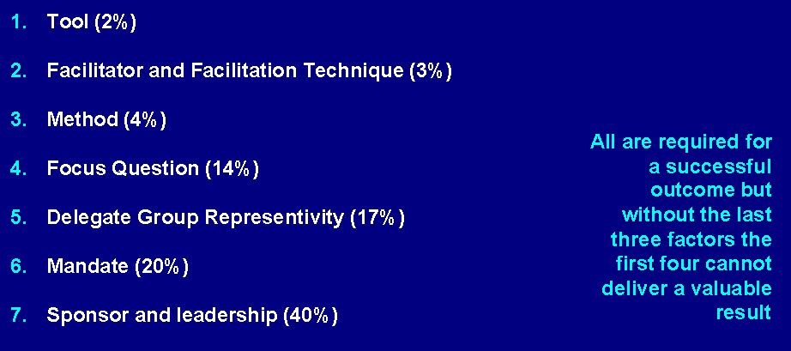
Relative contribution to a successful strategic analysis and design outcome

Slide 38
Examples of Focus Questions →
Right thing / Essence orientated questions
Critical Concerns with regard to the strategic direction of YOUR organization
Critical Drivers of …
Owner / Shareholder Critical Success Factors – why they have invested
Market Attractiveness Factors – the markets we WANT to do business with
Customer Critical Success factors – why customers buy from us in preference to our competitors
Critical Threats
Critical Business Information System (ERP) measurements and services
etc

Slide 39
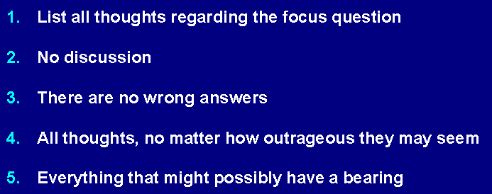
Brainstorm

Slide 40
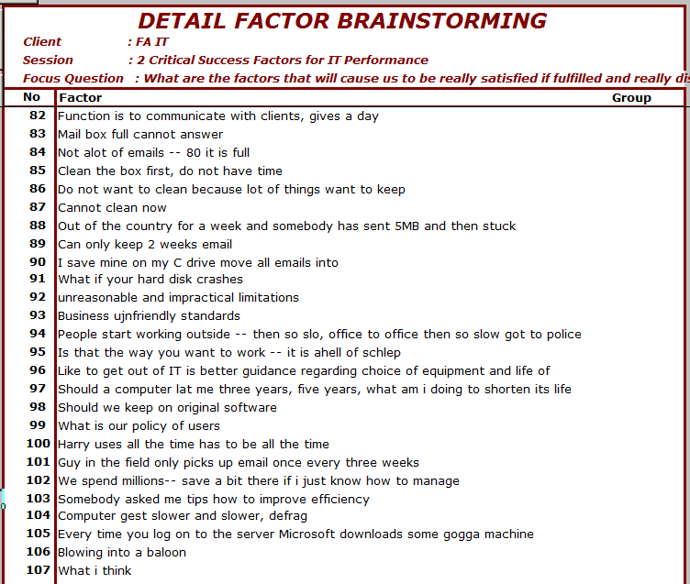
Brainstorm
Most “Strategic Plans” are merely brainstorm lists

Slide 41
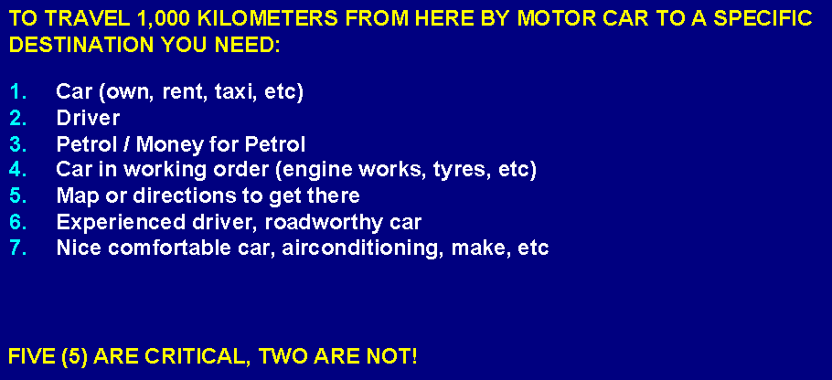
What ARE “Critical Factors?

Slide 42
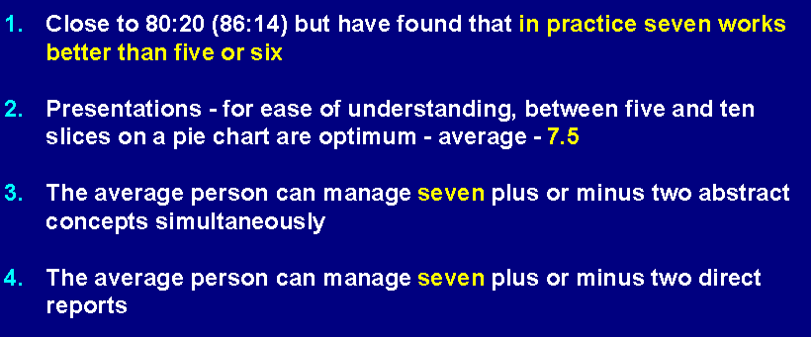
Why SEVEN factors?

Slide 43
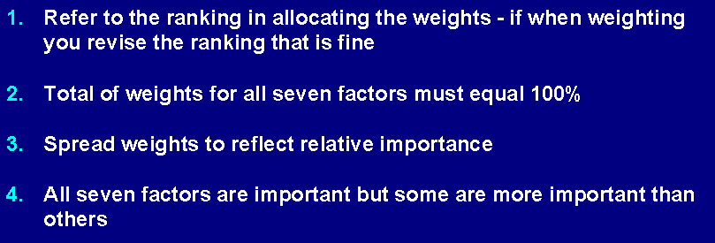
Weight determination

Slide 44
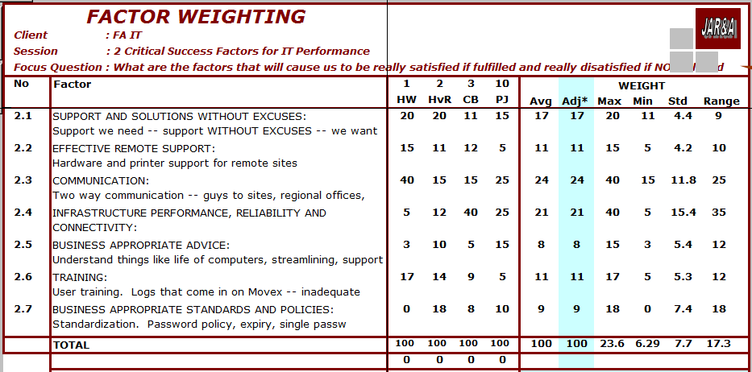
Critical Factors weighted

Slide 45
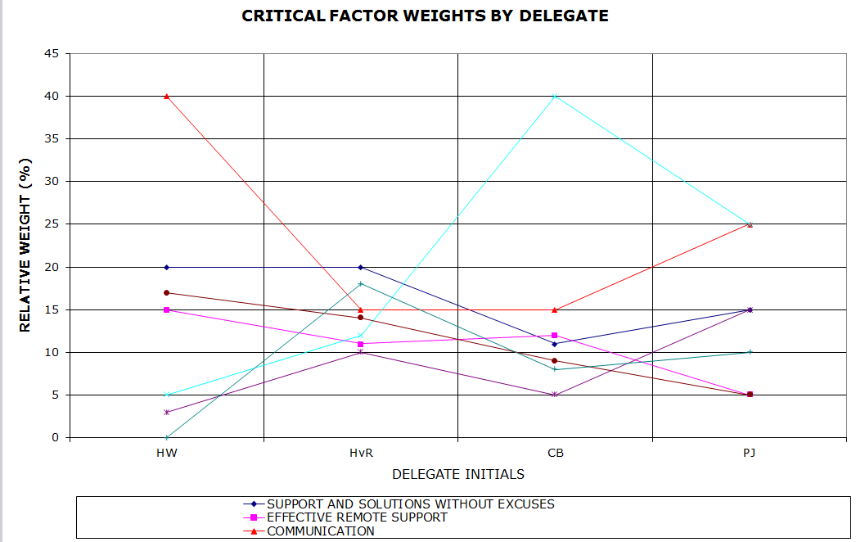
Weights are generally ALL OVER the place

Slide 46
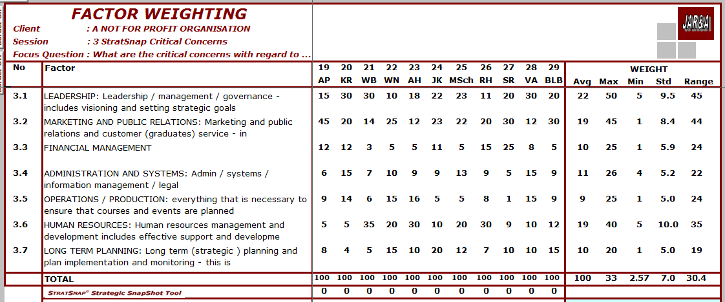
The reality of different perspectives

Slide 47
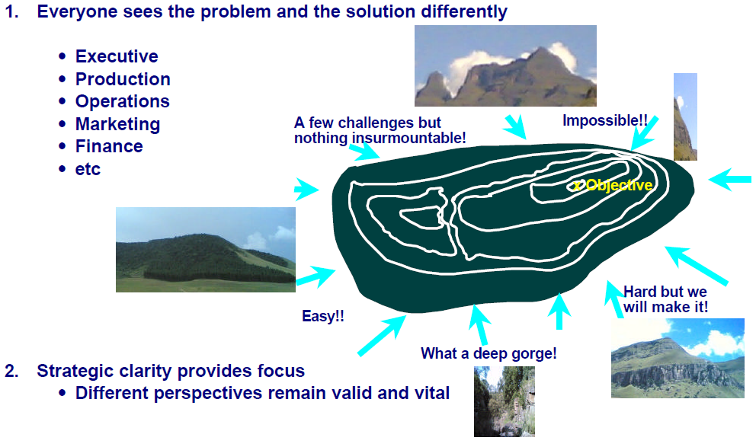
The reality of different perspectives

Slide 48
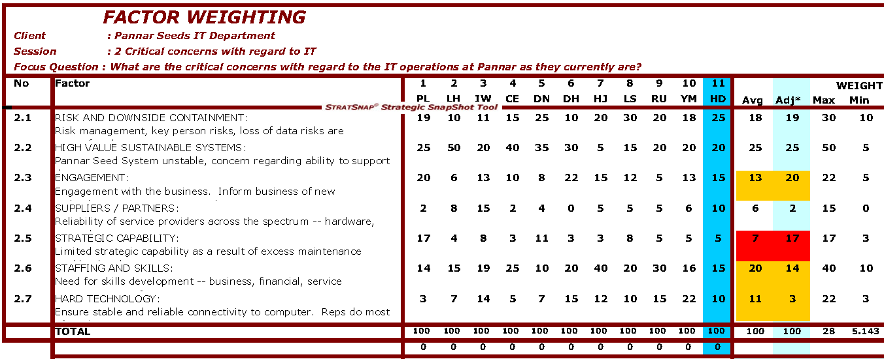
Highlighting priority conflict
Senior business analyst out of touch with the business

Slide 49
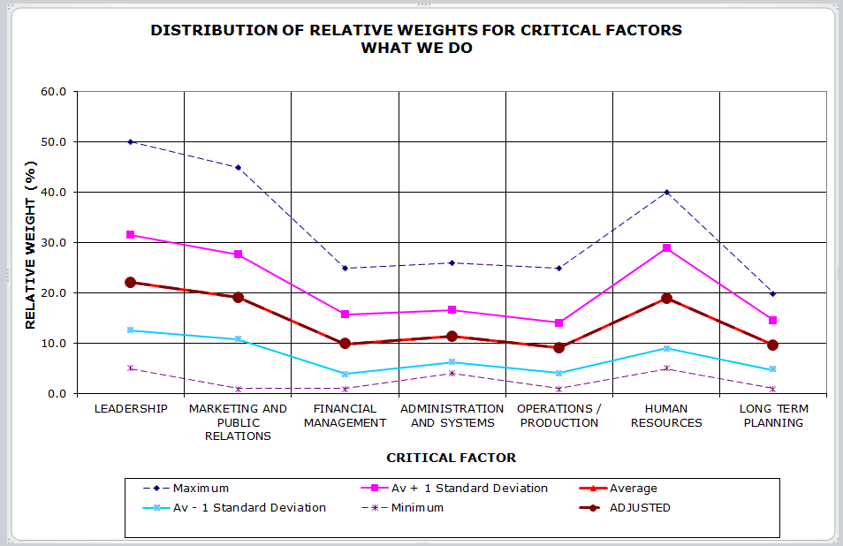
Summing up the weights -- uncertainty
Very wide range of opinions
LOW alignment
Intermediate range of opinions
MODERATE alignment

Slide 50
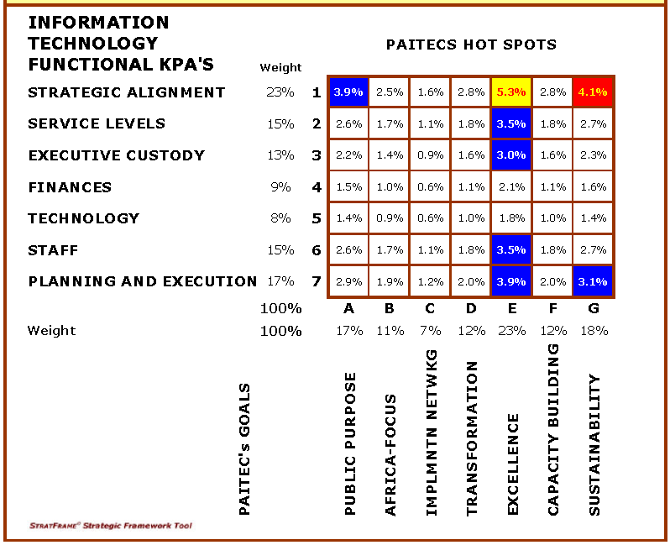
Governance Matrix – weighted priorities

Slide 51
Agenda
Strategy – what is it and how to develop actionable plans
What IS strategy really?
Strategy defined in one sentence that everyone understands
How to define the strategic environment?
How to measure strategic performance

Slide 52
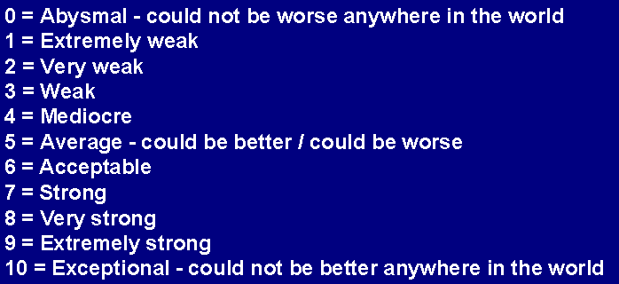
Scores and words to scores
Eleven (11) point scale gives space for nuances
Mid point for neutrality
Zero is important to negate a point if required
Most people have experience with zero to 10
Global reference minimizes different perspectives

Slide 53
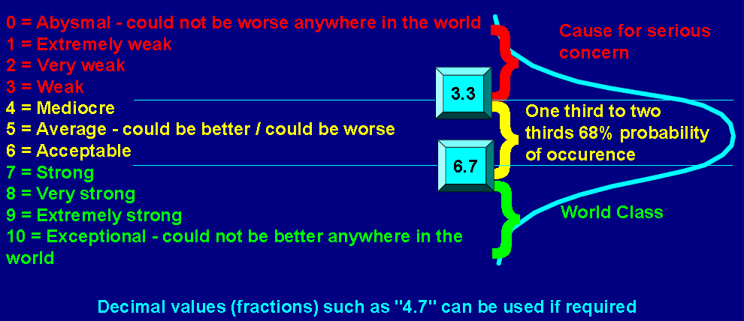
Scoring – practical considerations

Slide 54
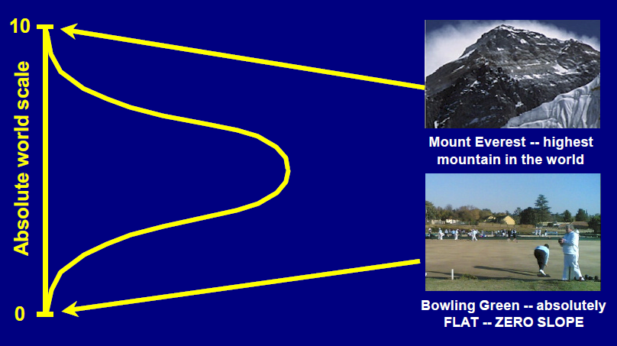

The Mount Everest phenomenon
versus YOUR local hill
Northcliff Johannesburg

Slide 55
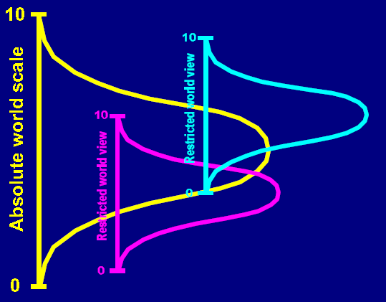
The challenge of personnel with different experiential backgrounds
Confusing factual analysis

Slide 56
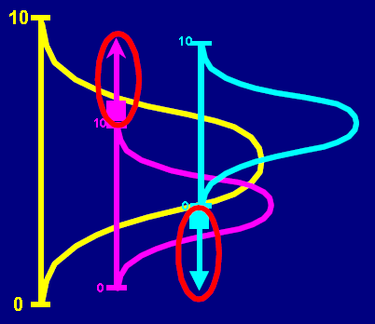
Stretching of worldviews
NOT that easy

Slide 57
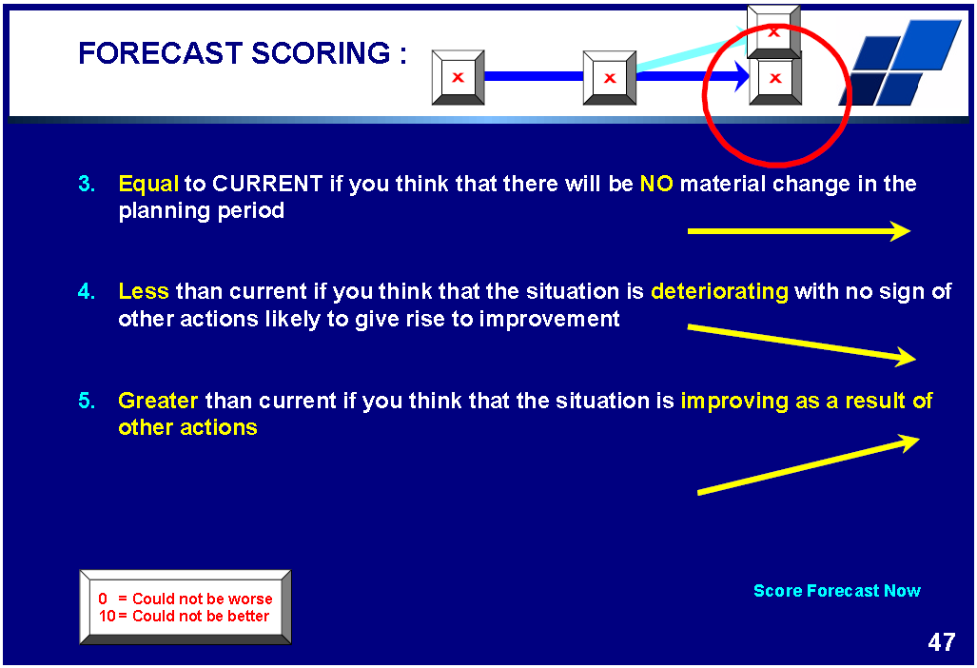
.

Slide 58
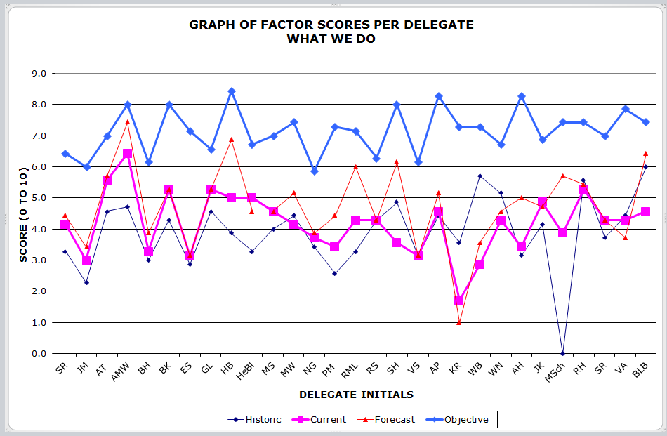
Score variability
29 delegates is a VERY large group
5 to 10 is optimal – views of the mountain
46% difference
massive difference of opinion
OR
major experiential difference

Slide 59
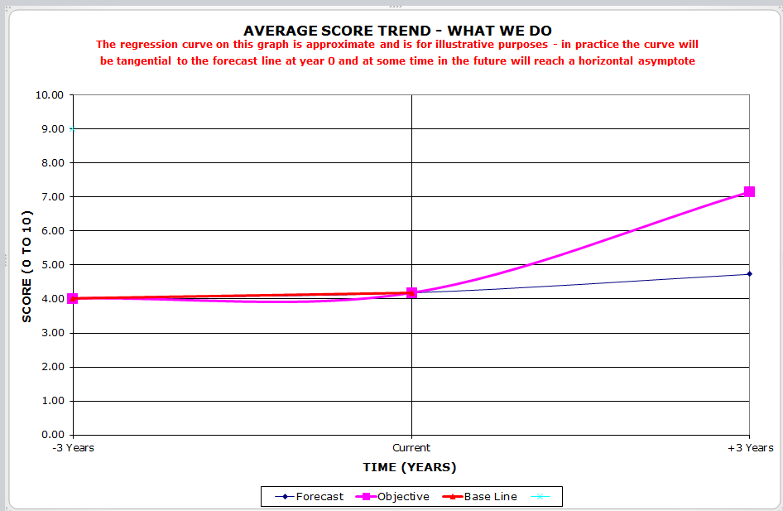
Typical Strategic Trajectory
Ho-hum with room for improvement

Slide 60
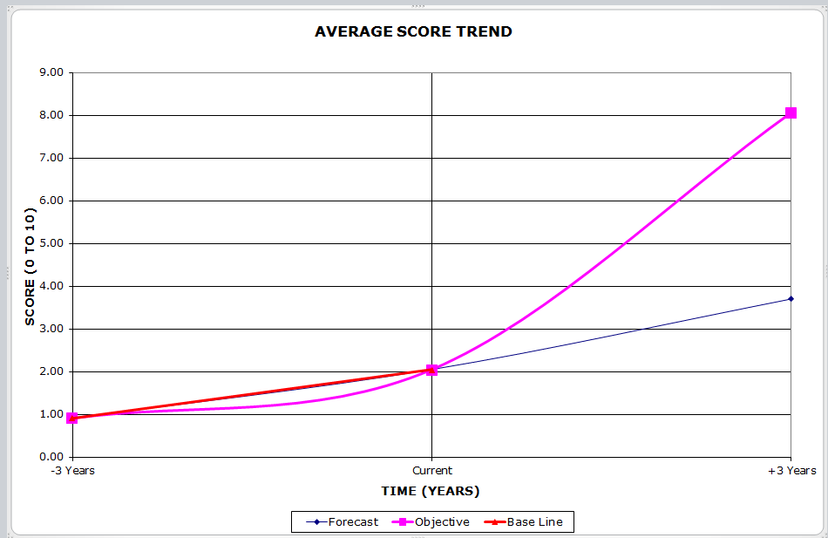
Strategic trajectory
Improving off a low base but want much more

Slide 61
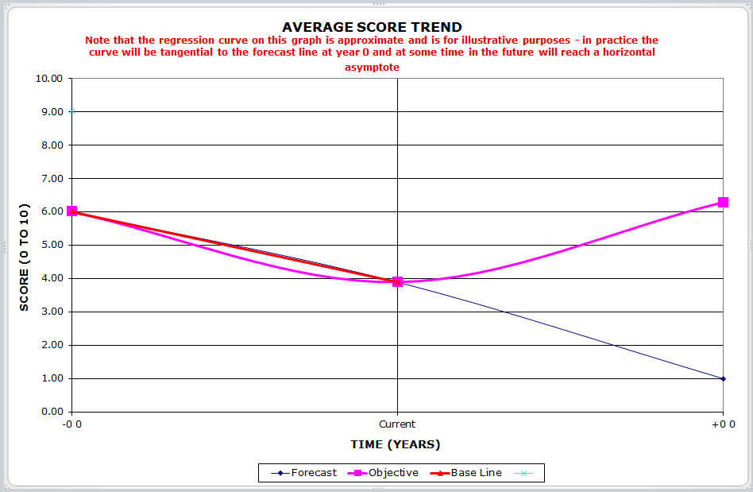
Strategic trajectory
Something is seriously wrong!

Slide 62
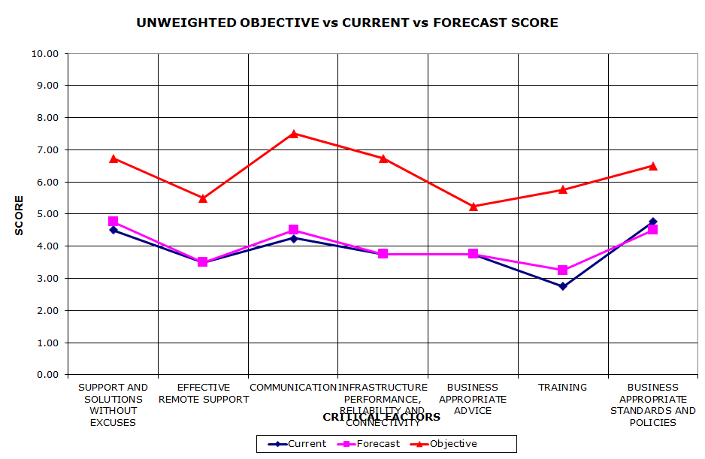
Unweighted gap
Priorities ALL look similar

Slide 63
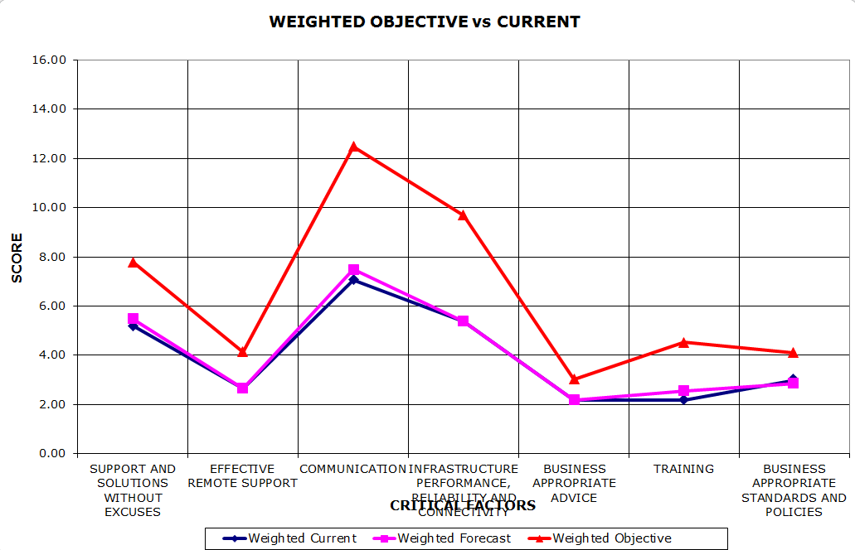
Weighted gap
Two factors stand out
Critical Gaps

Slide 64
Agenda
Strategy – what is it and how to develop actionable plans
What IS strategy really?
Strategy defined in one sentence that everyone understands
How to define the strategic environment?
How to measure strategic performance
Driving strategic performance through to measurable and actionable plans

Slide 65
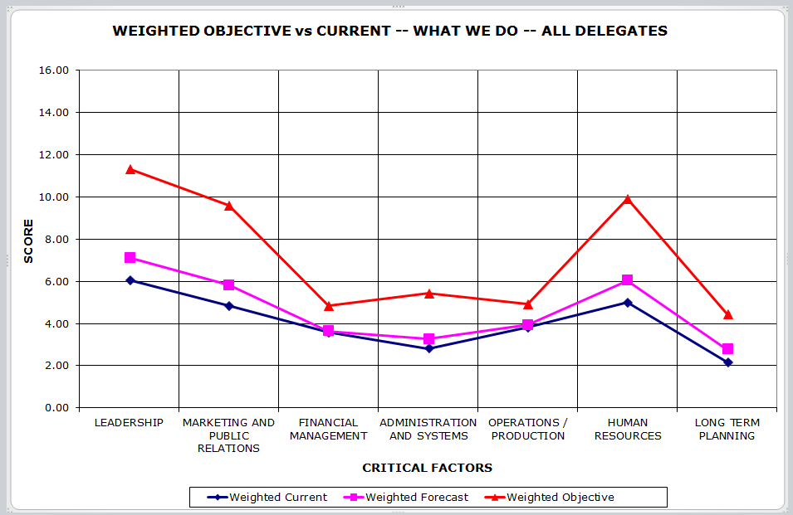
Weighted gap

Slide 66
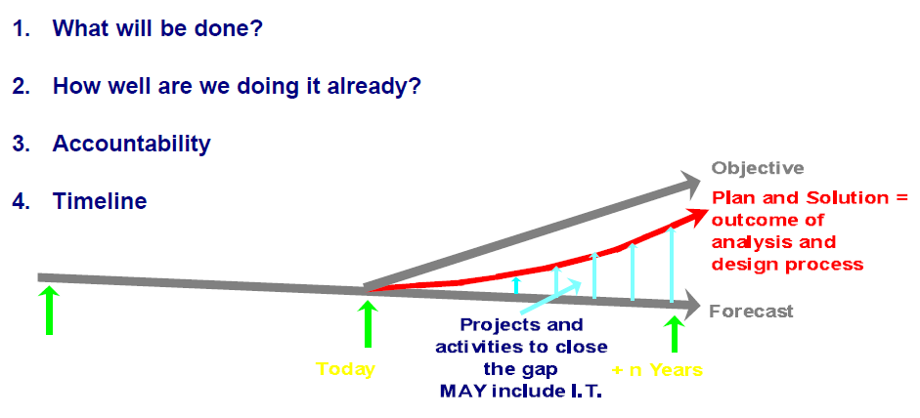
Gap analysis

Slide 67
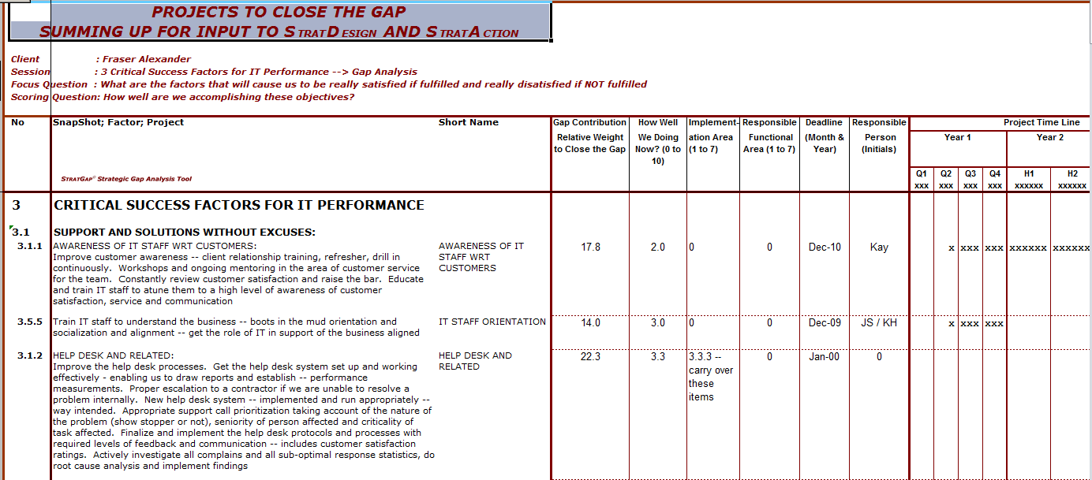
Detailed planning

Slide 68
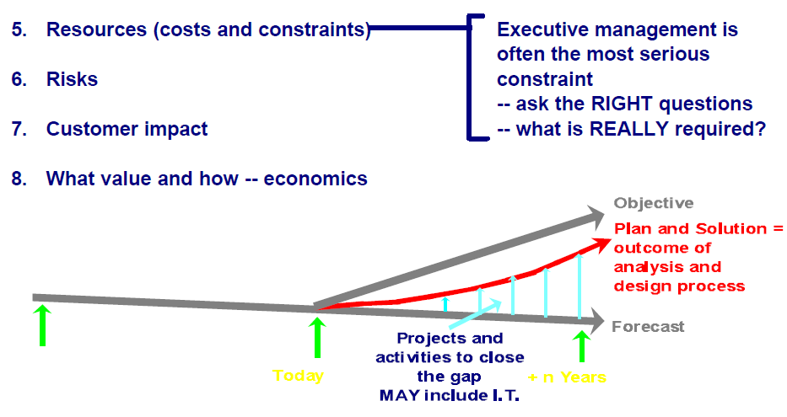
Gap analysis

Slide 69
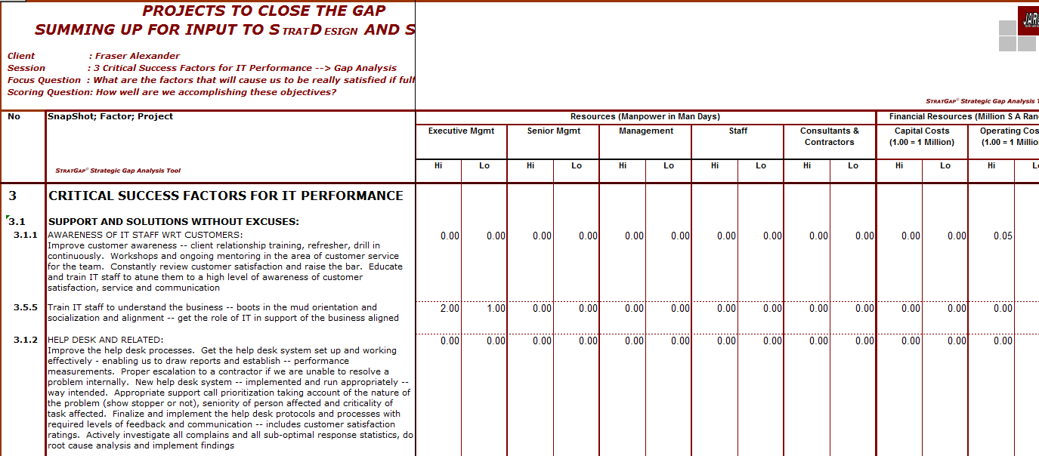
Executives – the critical constraint

Slide 70
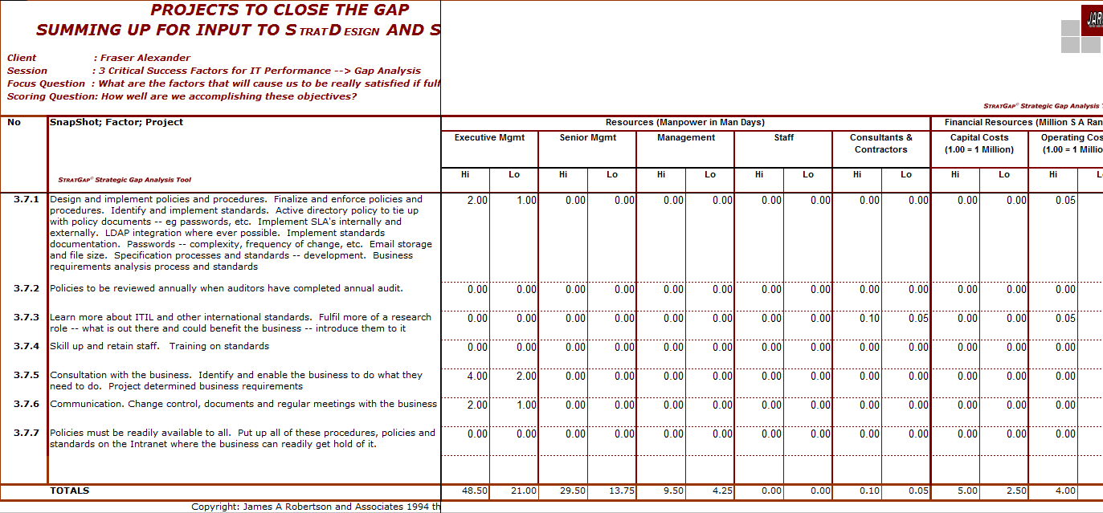
Executives – the critical constraint

Slide 71
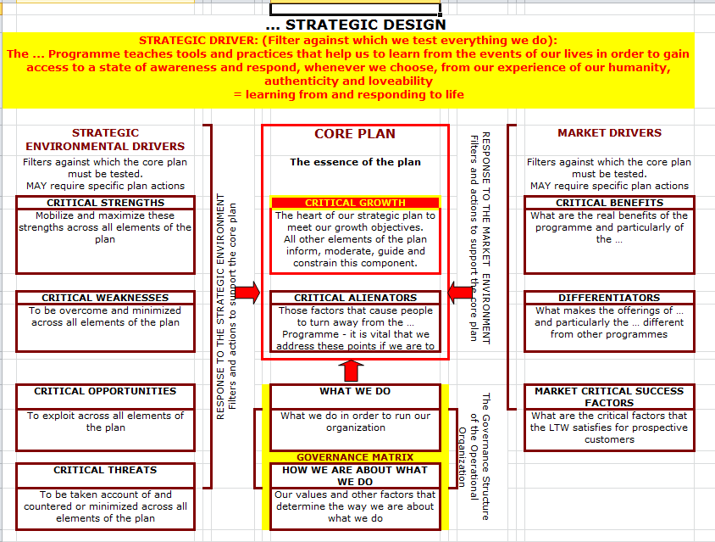
Takings thing further – strategic map
Multiple SnapShots©

Slide 72
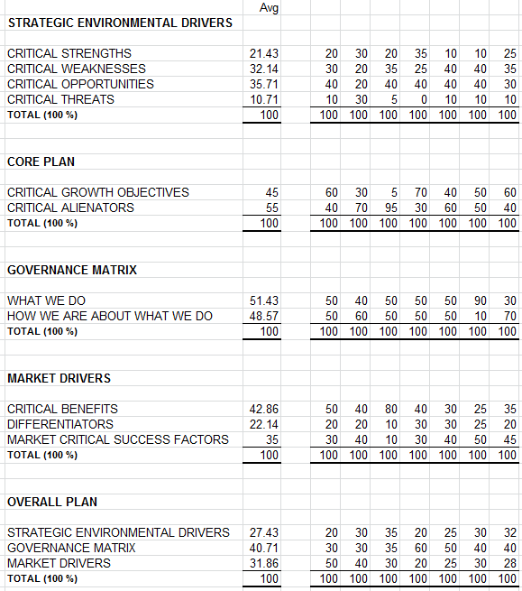
Weights applied to the strategic map

Slide 73
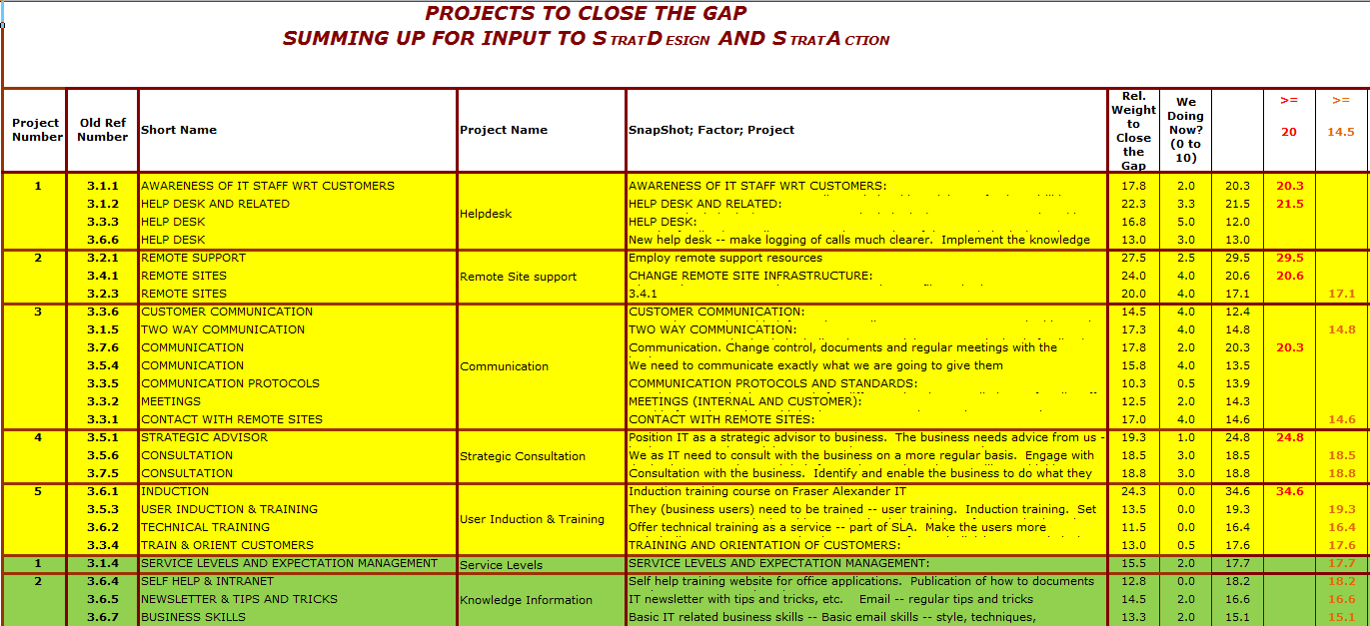
Example of a final plan

Slide 74
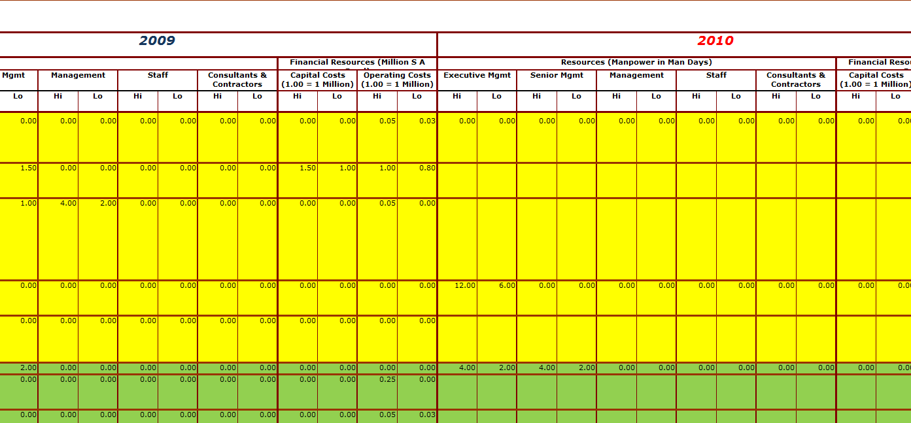
Example of a final plan continued

Slide 75

Developing the plan

Slide 76
Agenda
Strategy – what is it and how to develop actionable plans
What IS strategy really?
Strategy defined in one sentence that everyone understands
How to define the strategic environment?
How to measure strategic performance
Driving strategic performance through to measurable and actionable plans
Driving strategic performance through to Key Performance Indicators and Critical Competence

Slide 77
Personnel Strategically Aligned Key Performance Indicators (KPI’s)
Tell me how you are going to measure me and I will tell you how I am going to behave
Turn it around
Tell me how you want me to behave and I will tell you HOW to measure me

Slide 78

Developing the Key Performance Indicators for the Department, Head of Department and individual staff

Slide 79
Developing the Key Performance Indicators for the Department, Head of Department and individual staff
Brainstorm the measurements that will best determine if the specific Critical Factor is being satisfied
Synthesize approximately seven Critical KPI’s
Weight these KPI’s
Repeat for each Critical Factor
Apply the weights for the Critical Factors to compute relative weight of each proposed KPI
Select the plus minus seven KPI’s that will give the most significant measure of performance
Incorporate into personnel job descriptions and performance metrics
Score Department, or Head of Department or employee 0 to 10
Determine gaps and plan actions to improve

Slide 80
Developing Critical Competence = Knowledge and Experience requirements
Competence is actually the synthesis of knowledge, experience and aptitude (the first two can be developed)
Basic process is the same as for the KPI’s
Brainstorm headline areas of knowledge and experience
Synthesize the Critical Competence for each area
Weight and select overall areas of Critical Competence
Score 0 to 10 current, forecast and objective for knowledge, experience and aptitude separately – gives gaps
Analyze gaps and develop training, mentoring and other personnel development activities to close the gaps
Measure again

Slide 81
Agenda
Strategy – what is it and how to develop actionable plans
What IS strategy really?
Strategy defined in one sentence that everyone understands
How to define the strategic environment?
How to measure strategic performance
Driving strategic performance through to measurable and actionable plans
Driving strategic performance through to Key Performance Indicators
Summing up

Slide 82

Summing up

Slide 83

If you do not act within 48 hours you probably never will (Bill Gates)
Act TODAY! ☺
What is your single most important insight from this presentation?
What is the single most practical action that you can take tomorrow to apply strategic (right thing / essence thinking more effectively?
Please write down your thoughts
NOW
    James@Webinars-at-JARA.com

Slide 84


Questions?
We will email you a Drop Box link to my book, hand-outs and
recording of this presentation
JAR&A are available to assist in applying these principles
"To Him who by wisdom made the heavens, for His mercy endures forever;"
Dr James Robertson PrEng – The ERP Doctor -- Mobile: +27-(0)83-251-6644
www.James-A-Robertson-and-Associates.com
James@JamesARobertson.com
LinkedIn: http://za.LinkedIn.com/in/DrJamesARobertsonERPDoctor
Assisting clients to thrive through the effective application of IT and ERP – high value, high reliability solutions

